Slide 1
Analog Electronics for Communications
Semester 20192
Lecture 6

Slide 2
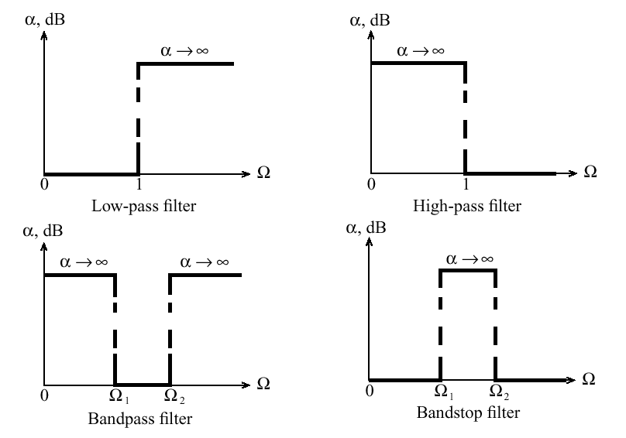
RF Filter Design – Basic Filter Types

Slide 3
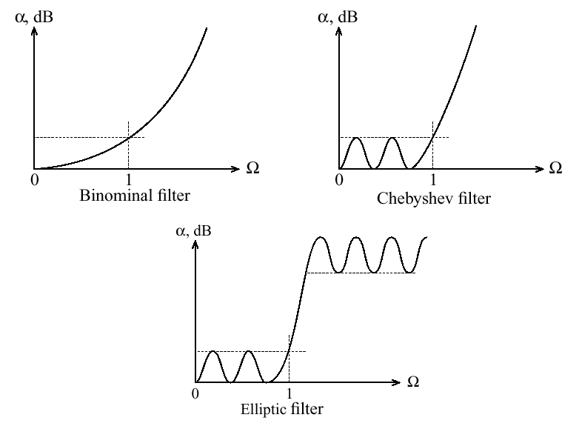
Filter Attenuation Profiles

Slide 4
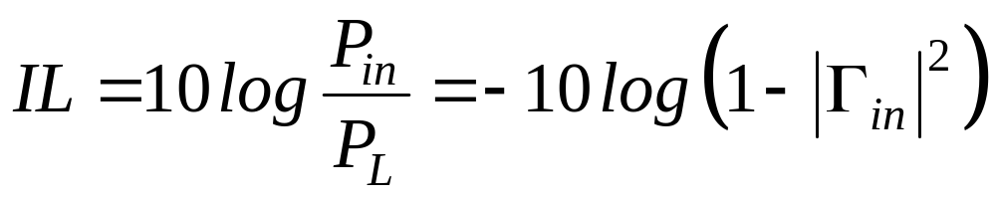
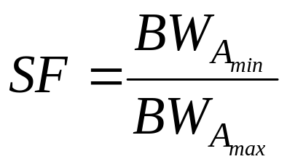
RF Filter Parameters
Insertion Loss:
Ripple
Bandwidth: BW ^{3dB} = f_{u}^{3dB} – f_{L}^{3dB}
Shape Factor:
Rejection

Slide 5
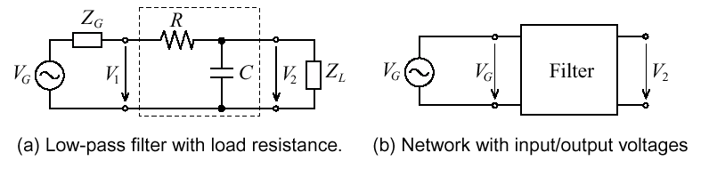
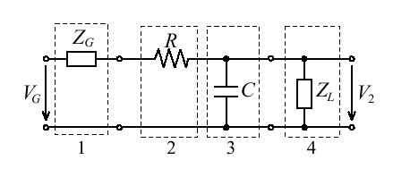
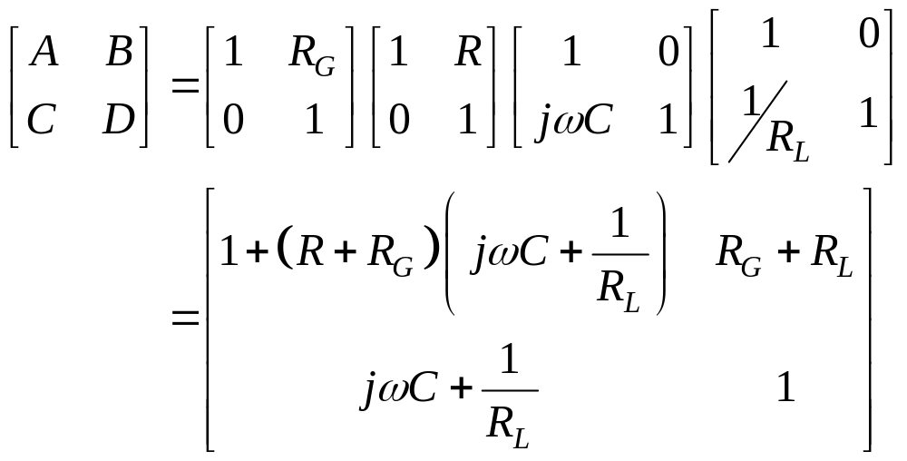
Low-Pass Filter
Cascading four ABCD-networks.

Slide 6
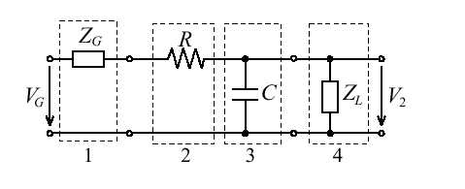
RF Filter Parameters
Cascading four ABCD-networks.

Slide 7
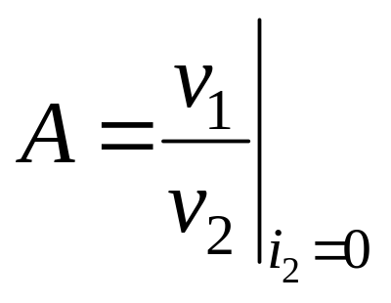
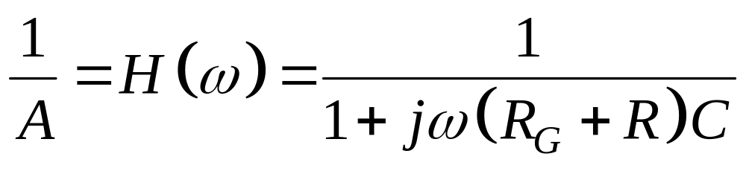
Low-Pass Filter Frequency Response
Frequency Response from the ABCD Definitions:
So the Transfer Function is Simply:

Slide 8
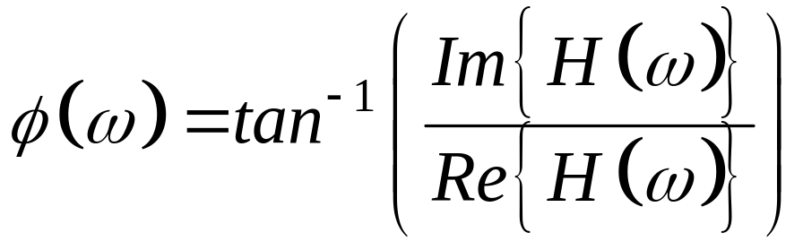
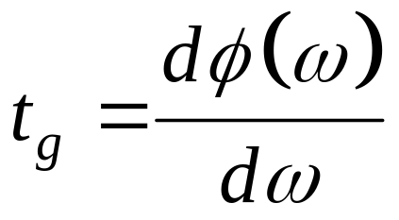
Low-Pass Filter Frequency Response
Corresponding Phase is:
Group Delay:

Slide 9
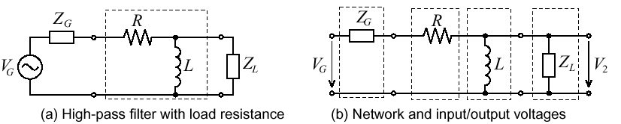
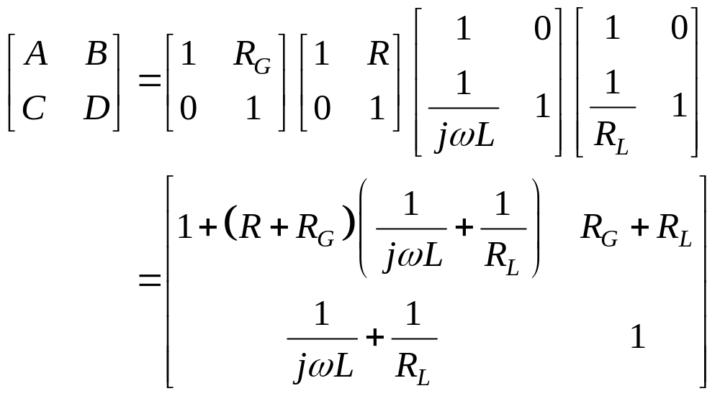
High-Pass Filter

Slide 10
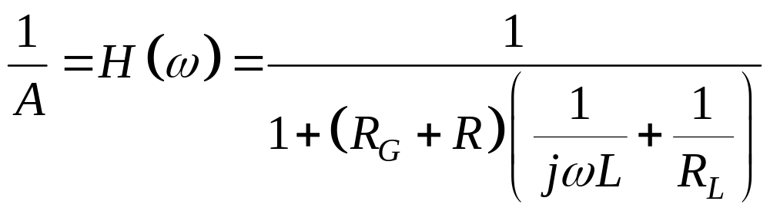
High-Pass Filter Frequency Response
Frequency Response from the ABCD Definitions:
So the Transfer Function is Simply:

Slide 11
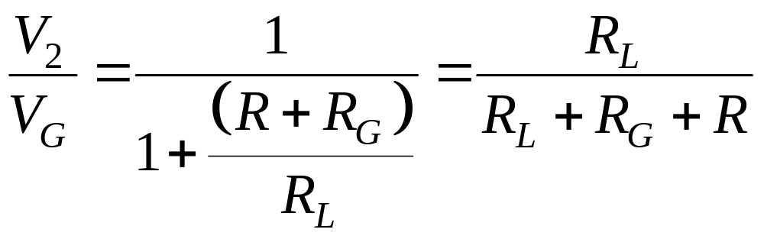
High-Pass Filter Frequency Response
For ω → ∞:
Inductive Influence Can Be Neglected

Slide 12
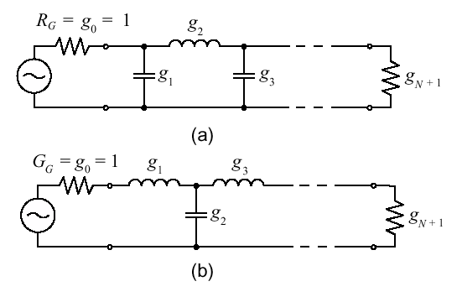
Low-Pass Filter Realizations

Slide 13
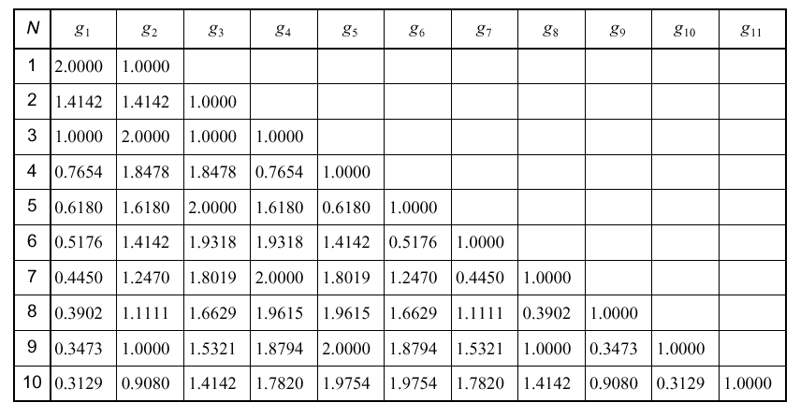
Low-Pass Butterworth Filter Coefficients

Slide 14
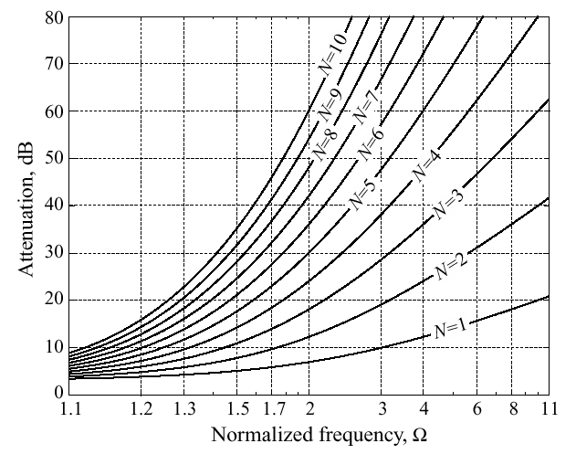
Low-Pass Butterworth Filter Attenuation

Slide 15
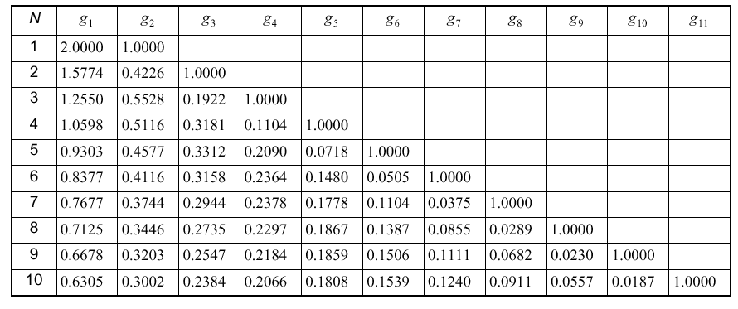
Low-Pass Linear-Phase Filter Coefficients

Slide 16
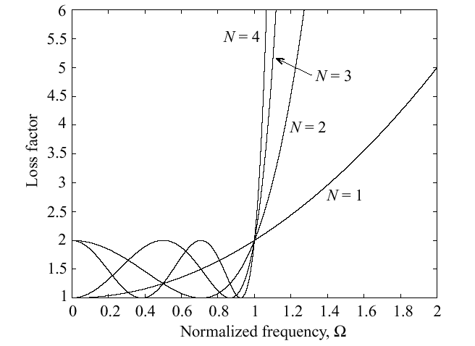
Chebyshev-Type Filters

Slide 17
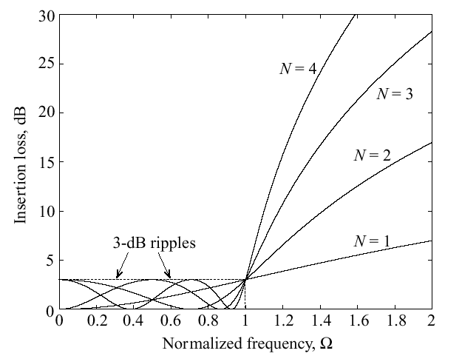
Chebyshev-Type Filters

Slide 18
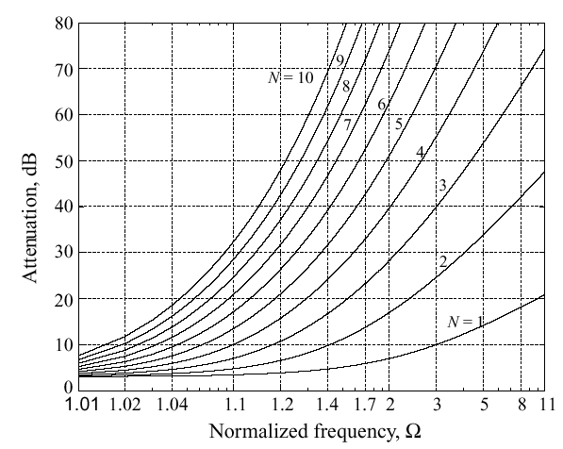
Chebyshev-Type Filter Response
Response for 3 dB ripple Chebyshev LPF

Slide 19
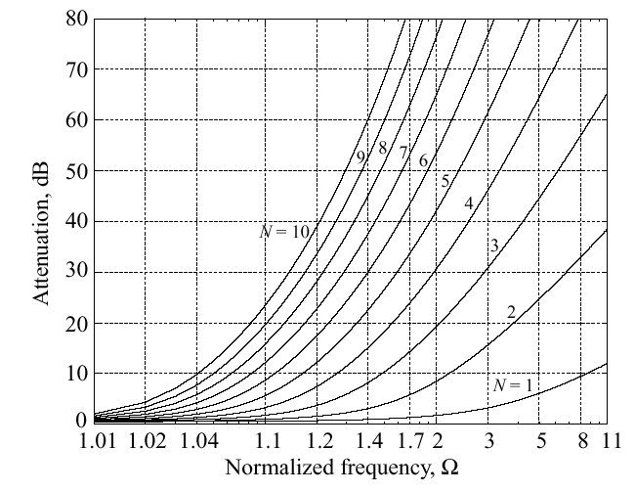
Chebyshev-Type Filter Response
Response for 0.5 dB ripple Chebyshev LPF

Slide 20
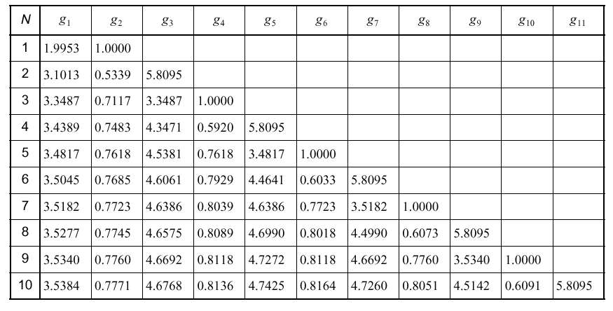
Low-Pass Chebysev Filter Coefficients – 3 dB Ripple

Slide 21
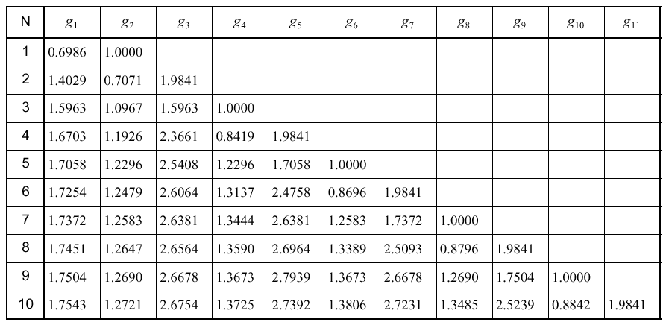
Low-Pass Chebysev Filter Coefficients – 0.5 dB Ripple

Slide 22
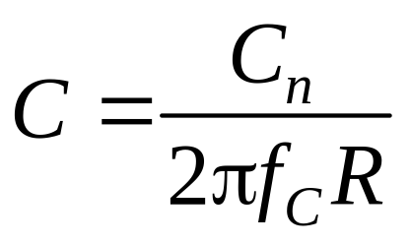
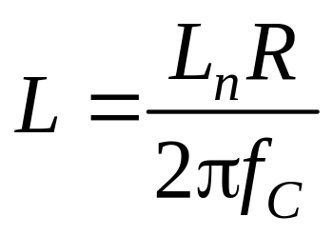
Standard Low-Pass Filter Design
The normalized inductors and capacitors (g₁, g₂ , ... , g_{N} ) are denormalized using:
and
where C_{n} , L_{n} , are the g_{n} normalized values from the tables

Slide 23
Low-Pass Filter Design Example
Design a Low-Pass Filter with cut-off frequency of 900 MHz and a stop band attenuation of 18 dB @1.8 GHz.
From the Butterworth Nomograph, A_{max} = 1 and A_{min} = 18. A_{max} = 1 since unity gain. And the order of the filter is N = 3.
From Butterworth Tables, g₁ = g₃=1.0 and g₂ = 2.

Slide 24
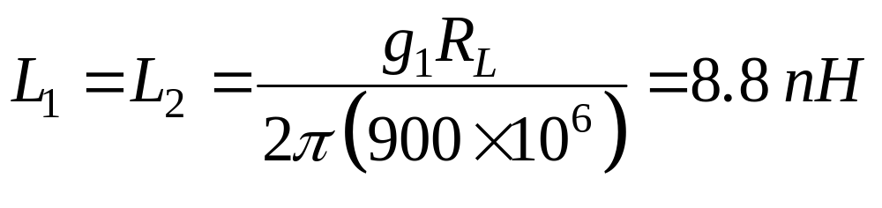
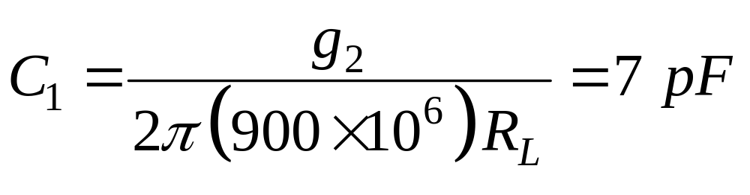
Low-Pass Filter Design Example
De-Normalized Values For the Tee-Configuration Low-Pass Filter Are:

Slide 25
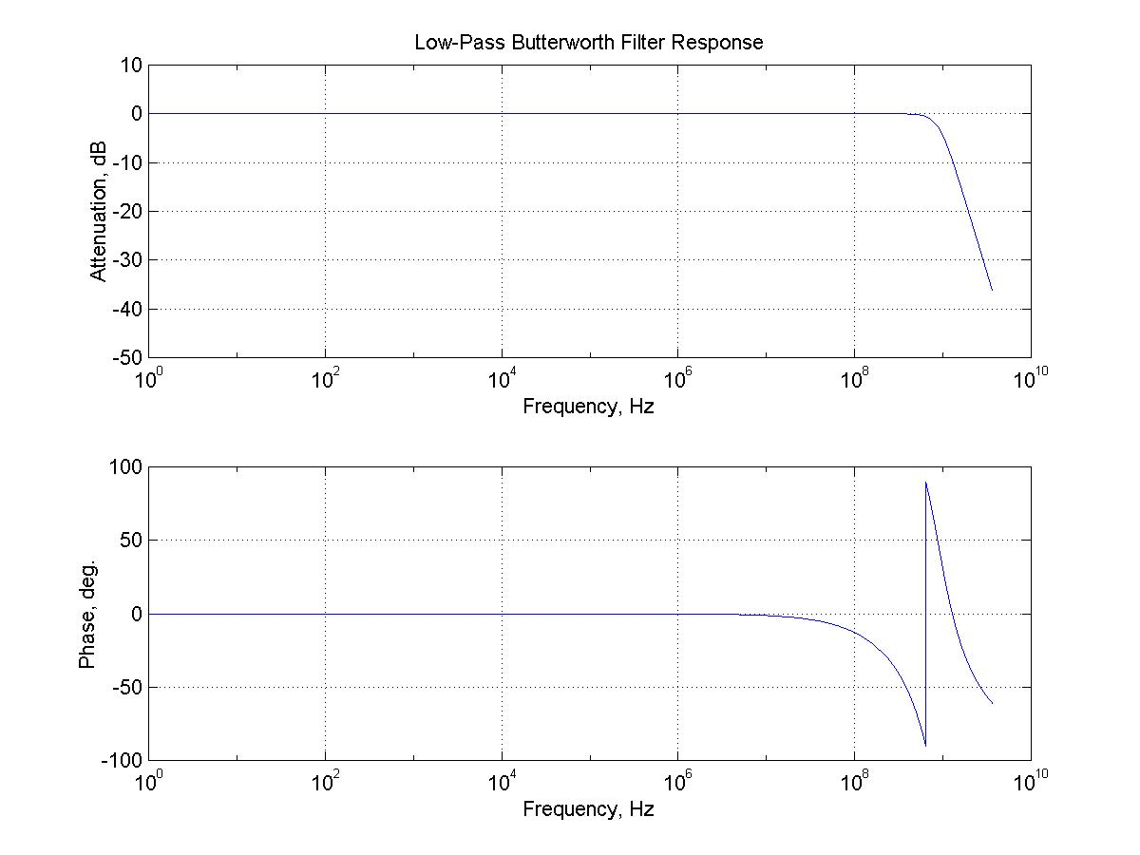
Low-Pass Filter Design Example

Slide 26
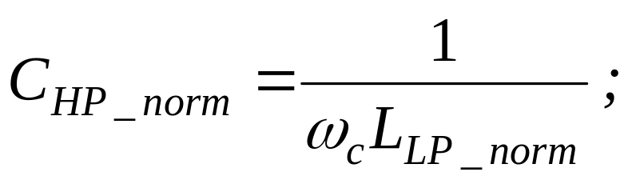
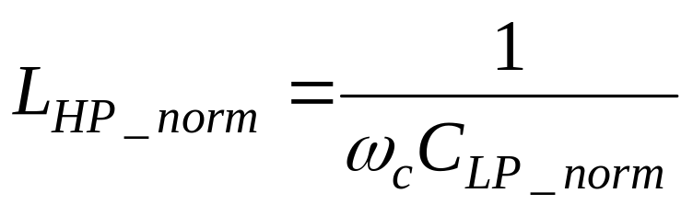
Low- To High-Pass Transformation
Transform the Low-Pass Filter Normalized Component Values to the Normalized High-Pass Values
Inductors in Low-Pass Configuration Become Capacitors in High-Pass.
Capacitors in Low-Pass Configuration Become Inductors in High-Pass

Slide 27
RF Filter Parameters
Insertion Loss:
Ripple
Bandwidth: BW ^{3dB} = f_{u}^{3dB} – f_{L}^{3dB}
Shape Factor:
Rejection

Slide 28
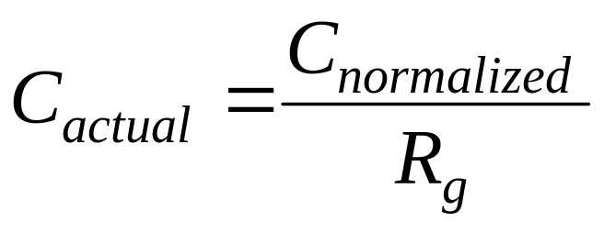
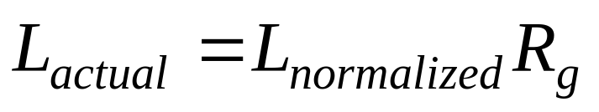
De-Normalizing Filter Component Values
All Normalized Component Values Are De-Normalized Using the Following:
and

Slide 29
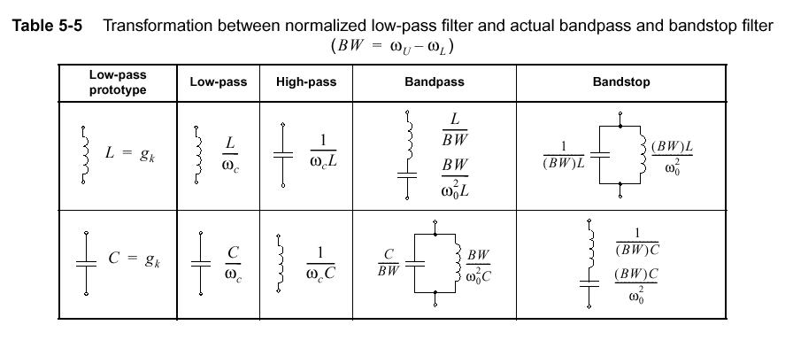
Transformation From Low-Pass Filter

Slide 30
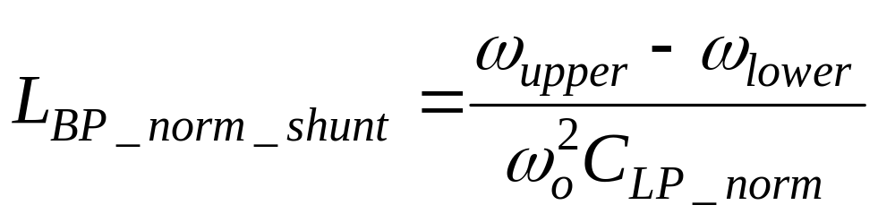
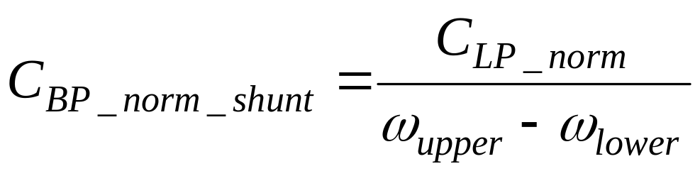
Normalized Low- to Band-Pass Filter Transformation
Normalized Band-Pass Shunt Elements from Shunt Low-Pass Capacitor:

Slide 31
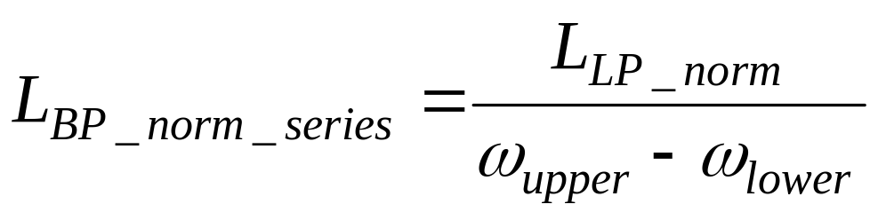
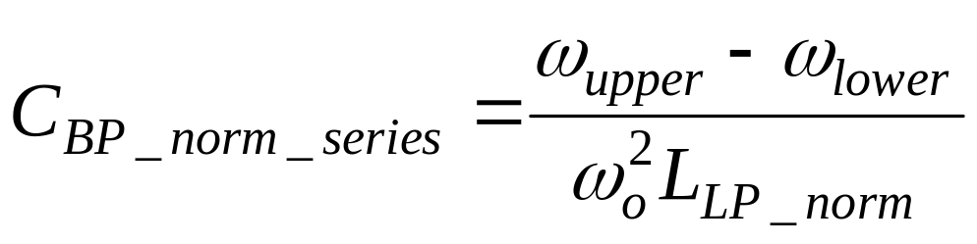
Normalized Low- to Band-Pass Filter Transformation
Normalized Band-Pass Series Elements from Series Low-Pass Inductor:

Slide 32
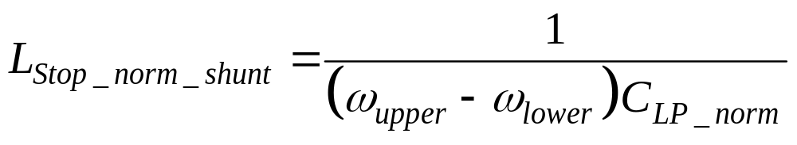
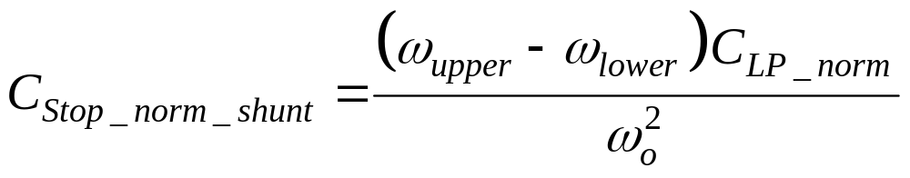
Normalized Low- to Band-Stop Filter Transformation
Normalized Band-Stop Shunt Component Values from Low-Pass Shunt Capacitor:

Slide 33
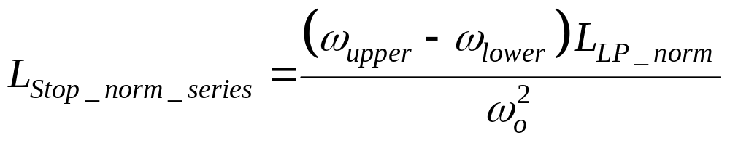
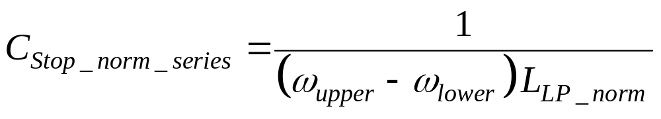
Normalized Low- to Band-Stop Filter Transformation
Normalized Band-Stop Series Component Values from Low-Pass Series Inductor:

